Slide 1
City Description and Comparison
Name:
Institution:

Slide 2
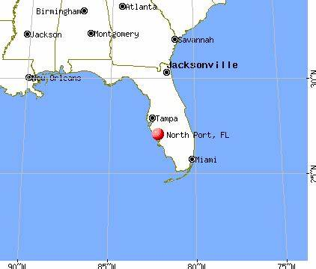
North Port, Florida
North Port is a city in Sarasota county in Florida, United States.
It is located at Latitude 27.06⁰N and Longitude 82.17⁰W.
North Port city is close to cities such as South Sarasota, Siesta Key and South Venice (Luer, 2002).

Slide 3
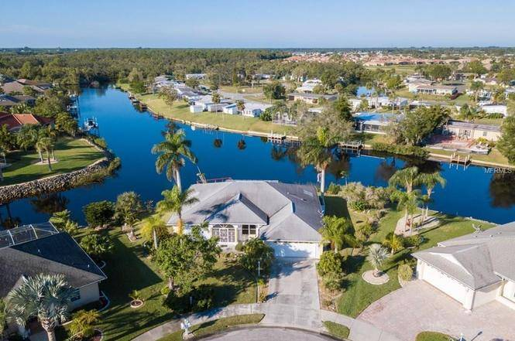
North Port, Florida
The city of North Port held a population of 71,397 as of July 2020.
Most of these people work in companies that do not create a huge negative impact to the environment (Luer, 2002).
Thus the city is mostly green with beautiful parks and beaches for recreation.

Slide 4
North Port, Florida
North Port’s resident are mostly US citizens who migrated from other states (Luer, 2002).
12% of the population are immigrants from the rest of the world.
The city contains multiple parks and roads with well-maintained sidewalks.
It is also a city full of serenity.

Slide 5
Sedona, Arizona
Sedona is located in the northern parts of Verde Valley, Arizona, United States.
The city is situated at the borderline between Coconino and Yavapai counties (Authier, 2013).
It is located at latitude 34.86⁰N and longitude 11.76⁰W
Sedona boasts of plateaus and red rocks that characterize the Verde Valley.

Slide 6

Sedona, Arizona

Slide 7
Sedona, Arizona
Sedona’s population is estimated to be 10,301 as at 2020.
Most of the major activities in Sedona is tourism, hiking, fishing, mountain biking, among others (Coats, 2009).
These activities ensure that Sedona retains most of its natural aspects.
Most of the people living in Sedona have been born and raised in the city, with only 13% of foreigners.

Slide 8
Comparison Between North Port and Sedona
Both cities maintain their naturalization as North Port maintains its green features and Sedona it red rocks.
The population in both cities is below 100,000, meaning that they are both small cities.
In both cities, the population of immigrants is extremely low in relation to the population of natives.
Both cities contain multiple recreation sites.

Slide 9
Contrast Between North Port and Sedona
North Port has multiple companies where its residents can acquire jobs while Sedona mostly have hotels and homes for rent as the main businesses.
Sedona contains a variety of tourist attraction sites while North Port may be visited only for its peace and tranquility.
While North Port is green and full of parks, Sedona is characterized with red rocks, and raised plateaus.

Slide 10
Conclusion
Moving from Florida to Arizona may require a massive shift in adaptation.
However, the differences between North Port, Florida and Sedona, Arizona may be minimal.
There are multiple recreation activities in Sedona and multiple visitors every now and then.
The population is also as small and quiet, as it is in North Port.

Slide 11
References
Coats, C. (2009). Sedona, Arizona: New age pilgrim-tourist destination. CrossCurrents, 59(3), 383-389.
Authier, C. I. (2013). The psychology of place: A qualitative study of mid-life relocation to Sedona, Arizona. California Institute of Integral Studies.
Luer, G. M. (2002). Three Middle Archaic Sites in North Port. Archaeology of Upper Charlotte Harbor, Florida. Florida Anthropological Society Publication, (15), 3-33.

